Slide 1

UNID : UMIP20537

Slide 2

INtroduction
Unified Mentor Coffee is a small company who provides coffee sales from a vending machine in Gurgaon Cyber City. The owner of the company now want to know the analysis and demographics of the sales of the coffee vending machine. She provided the dataset for analysis. This dataset contains detailed records of coffee sales from a vending machine. The vending machine is the work of a dataset author who is committed to providing an open dataset to the community. It is intended for analysis of purchasing patterns, sales trends, and customer preferences related to coffee products. The dataset spans from March 2024 to August 2024, capturing daily transaction data.

Slide 3
BUSiness problems
In each month, how much earned by the vending machine
Revenues by coffee types
In every hour, which coffee type sold more than others
Popularity of coffee types
Card holder to spend most amount to buy coffee
From which type of transaction, company earned most

Slide 4
Techniques used - i
We used Python and it’s libraries like Pandas, Matplotlib, Seaborn, Plotly and Scikit-learn to solve the business problems
1. In each month, how much earned by the vending machine
-> We used Pandas and Plotly Bar Chart to find out the sales amount of coffees
2. Revenues by coffee types
-> We used Pandas and Plotly Scatter Plot to find out the revenues of coffees
3. In every hour, which coffee type sold more than others
-> We used Pandas and Plotly Multi-line Chart to find out the sales of coffee types in every hour

Slide 5
Techniques used - ii
We used Python and it’s libraries like Pandas, Matplotlib, Seaborn, Plotly and Scikit-learn to solve the business problems
4. Popularity of coffee types
-> We used Pandas and Plotly Bar Chart to find out the popularity of coffee types
5. Card holder to spend most amount to buy coffee
-> We used Pandas and Plotly Bar Chart to find out the card holder to spend most amount
6. From which type of transaction, company earned most
-> We used Pandas and Plotly Multi-line Chart to find out the company earned most from transaction type

Slide 6
Techniques used - iii
Now, we used Scikit-learn for ML model building and prediction of sales in upcoming month.
Here, we used several ML algorithms like, Linear Regression, Decision Tree Regressor, Random Forest Regressor and Gradient Boosting to solve the regression problems. We found that Random Forest provide most accuracy with Mean Squared Error (MSE): 0.20 which is less than other models and R-squared: 0.99 which is more accurate than others.
So, we used Random Forest to predict the next month total sales of coffee from that vending machine.

Slide 7
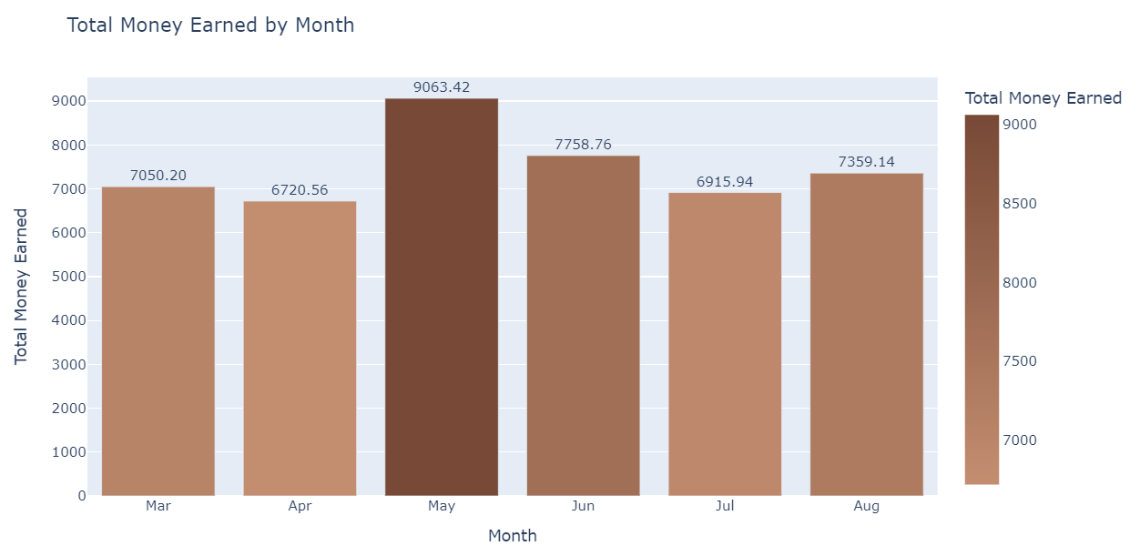
Solutions - i
In each month, how much earned by the vending machine
From the bar chart, we can see May had the highest sales of coffee, while April had the lowest sales of coffee
May Sales Amount :
Rs. 9063.42
April Sales Amount :
Rs. 6720.56

Slide 8
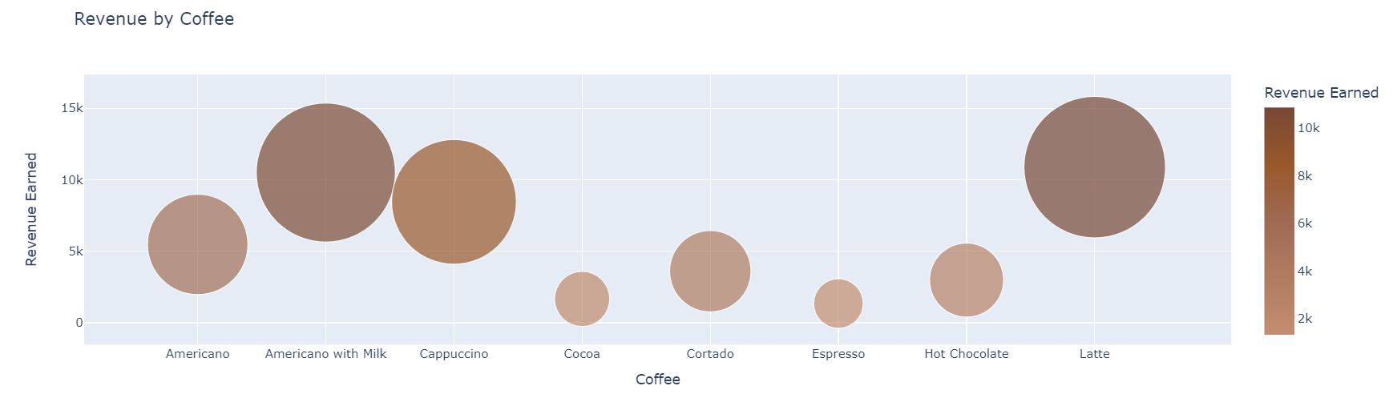
Solutions - ii
Revenues by coffee types
From the above scatter plot, we can notice Americano with Milk and Latte coffees are almost same revenue earned, which was approximately Rs. 10K

Slide 9
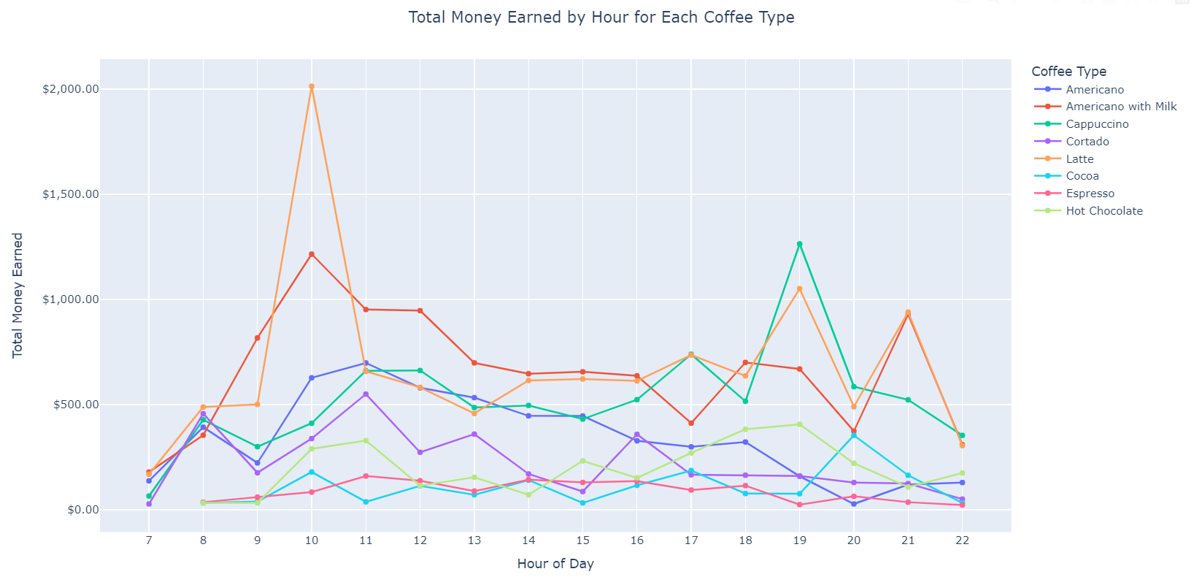
Solutions - iii
In every hour, which coffee type sold more than others
From the multi-line chart, we can see from 9 AM to 11 AM and from 6 PM to 8 PM, sales of coffee increased more than other hours and Latte sold more than others coffee.

Slide 10
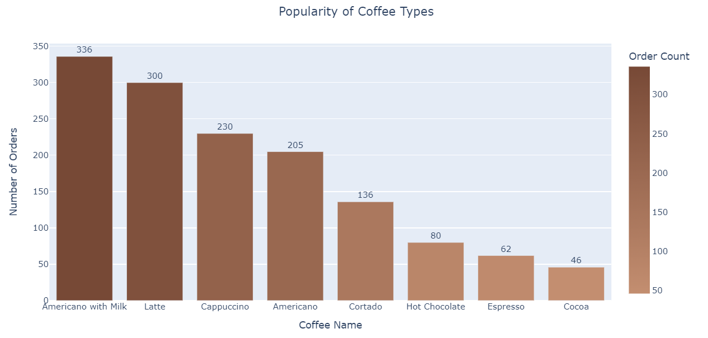
Solutions - iv
Popularity of coffee types
From the bar chart, we can see Americano with Milk coffee had the highest orders count, while Latte was the next one of the highest orders.
So, Americano with Milk and Latte were most popular coffee.

Slide 11
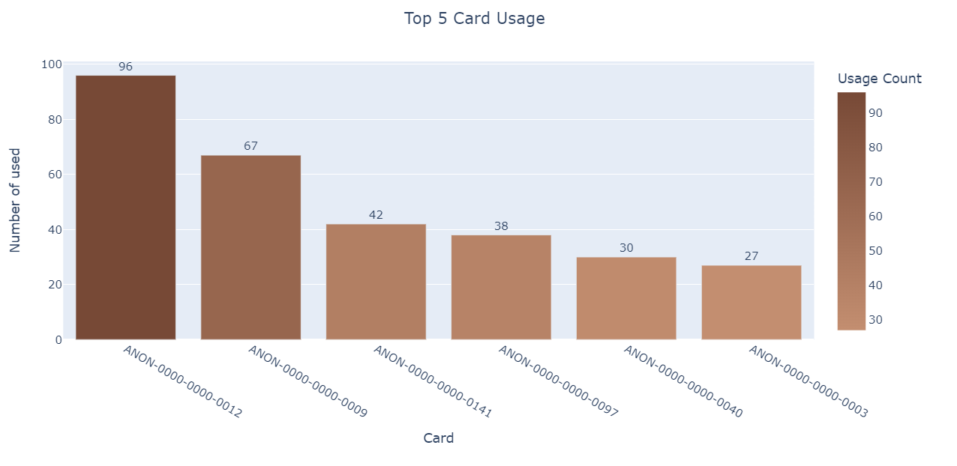
Solutions - v
Card holder to spend most amount to buy coffee
From the bar chart, we can see card holder of Card No : ANON-0000-0000-0012 bought more coffee from machine which was 96 times he/she bought coffee.
So, He/She was the top customer.

Slide 12
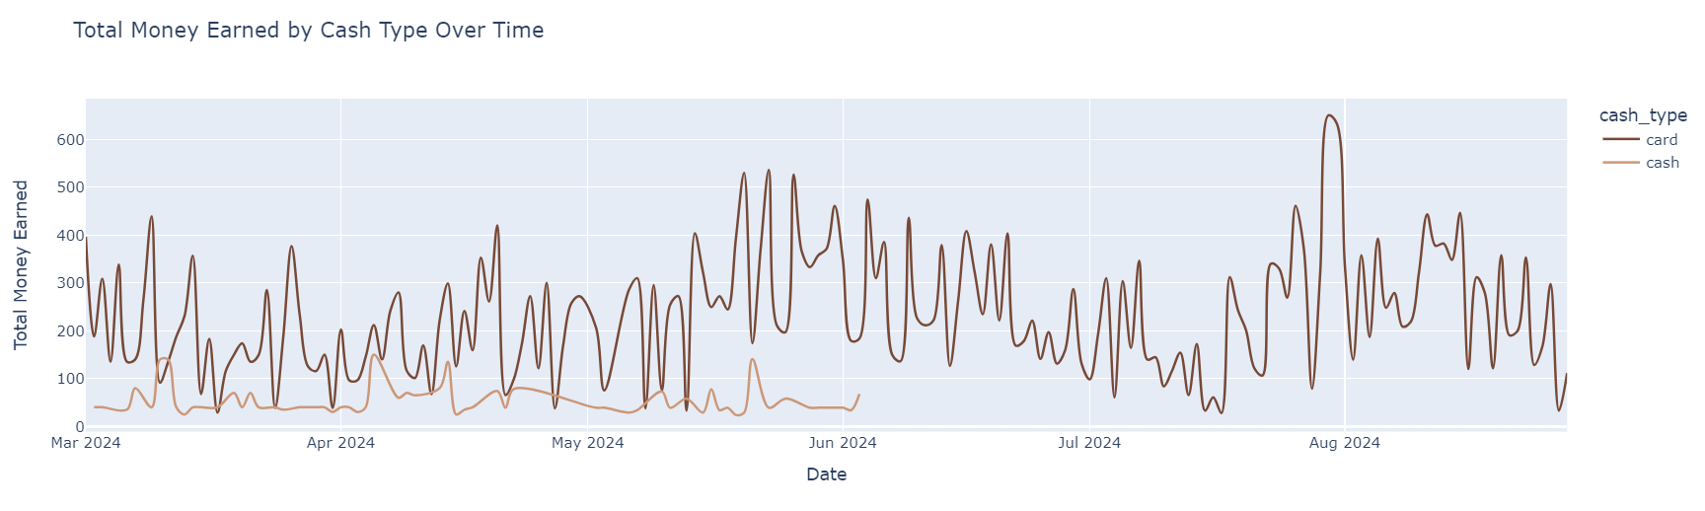
Solutions - vi
From which type of transaction, company earned most
From the above line chart, we can notice in every month transaction by CARD is more than CASH usage in vending machine

Slide 13
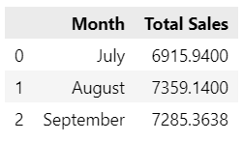
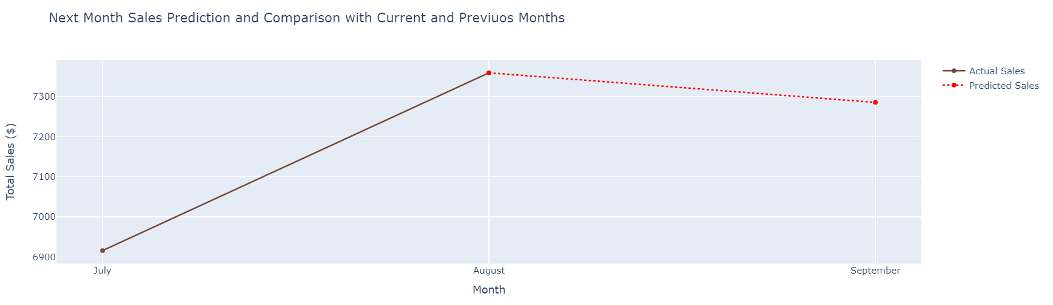
Solutions - vii
Next Month Sales Prediction and Sales Comparison with Current & Previous Month
From the above table, we can notice July and August (Current month according to given dataset) had sales of Rs. 6915.94 and Rs. 7359.14 repectively. We used Random Forest Regressor model to predict the sales of September (Next month according to dataset), which is Rs. 7285.36, the sales value of September decreased from August. With the help of line chart we have shown the sales data of previous, current and future months. In the chart predicted sales value has been shown in red dotted line.

Slide 14
Conclusion
From the detailed analysis of the UM COFFEE Sales Data, we have noticed that :
In May, the sales was more than other months ( March – August).
Americano with Milk & Latte coffee had highest amount of sales. So, those were the most popular coffees.
In Morning from 9 AM to 11 AM and In Evening 6 PM to 8 PM, most amount of coffee sold and earned most revenue in those hours.
Most of the customers used CARD rather than CASH option.
The next month’s predicted total sales will be decreased from last month.

Slide 15
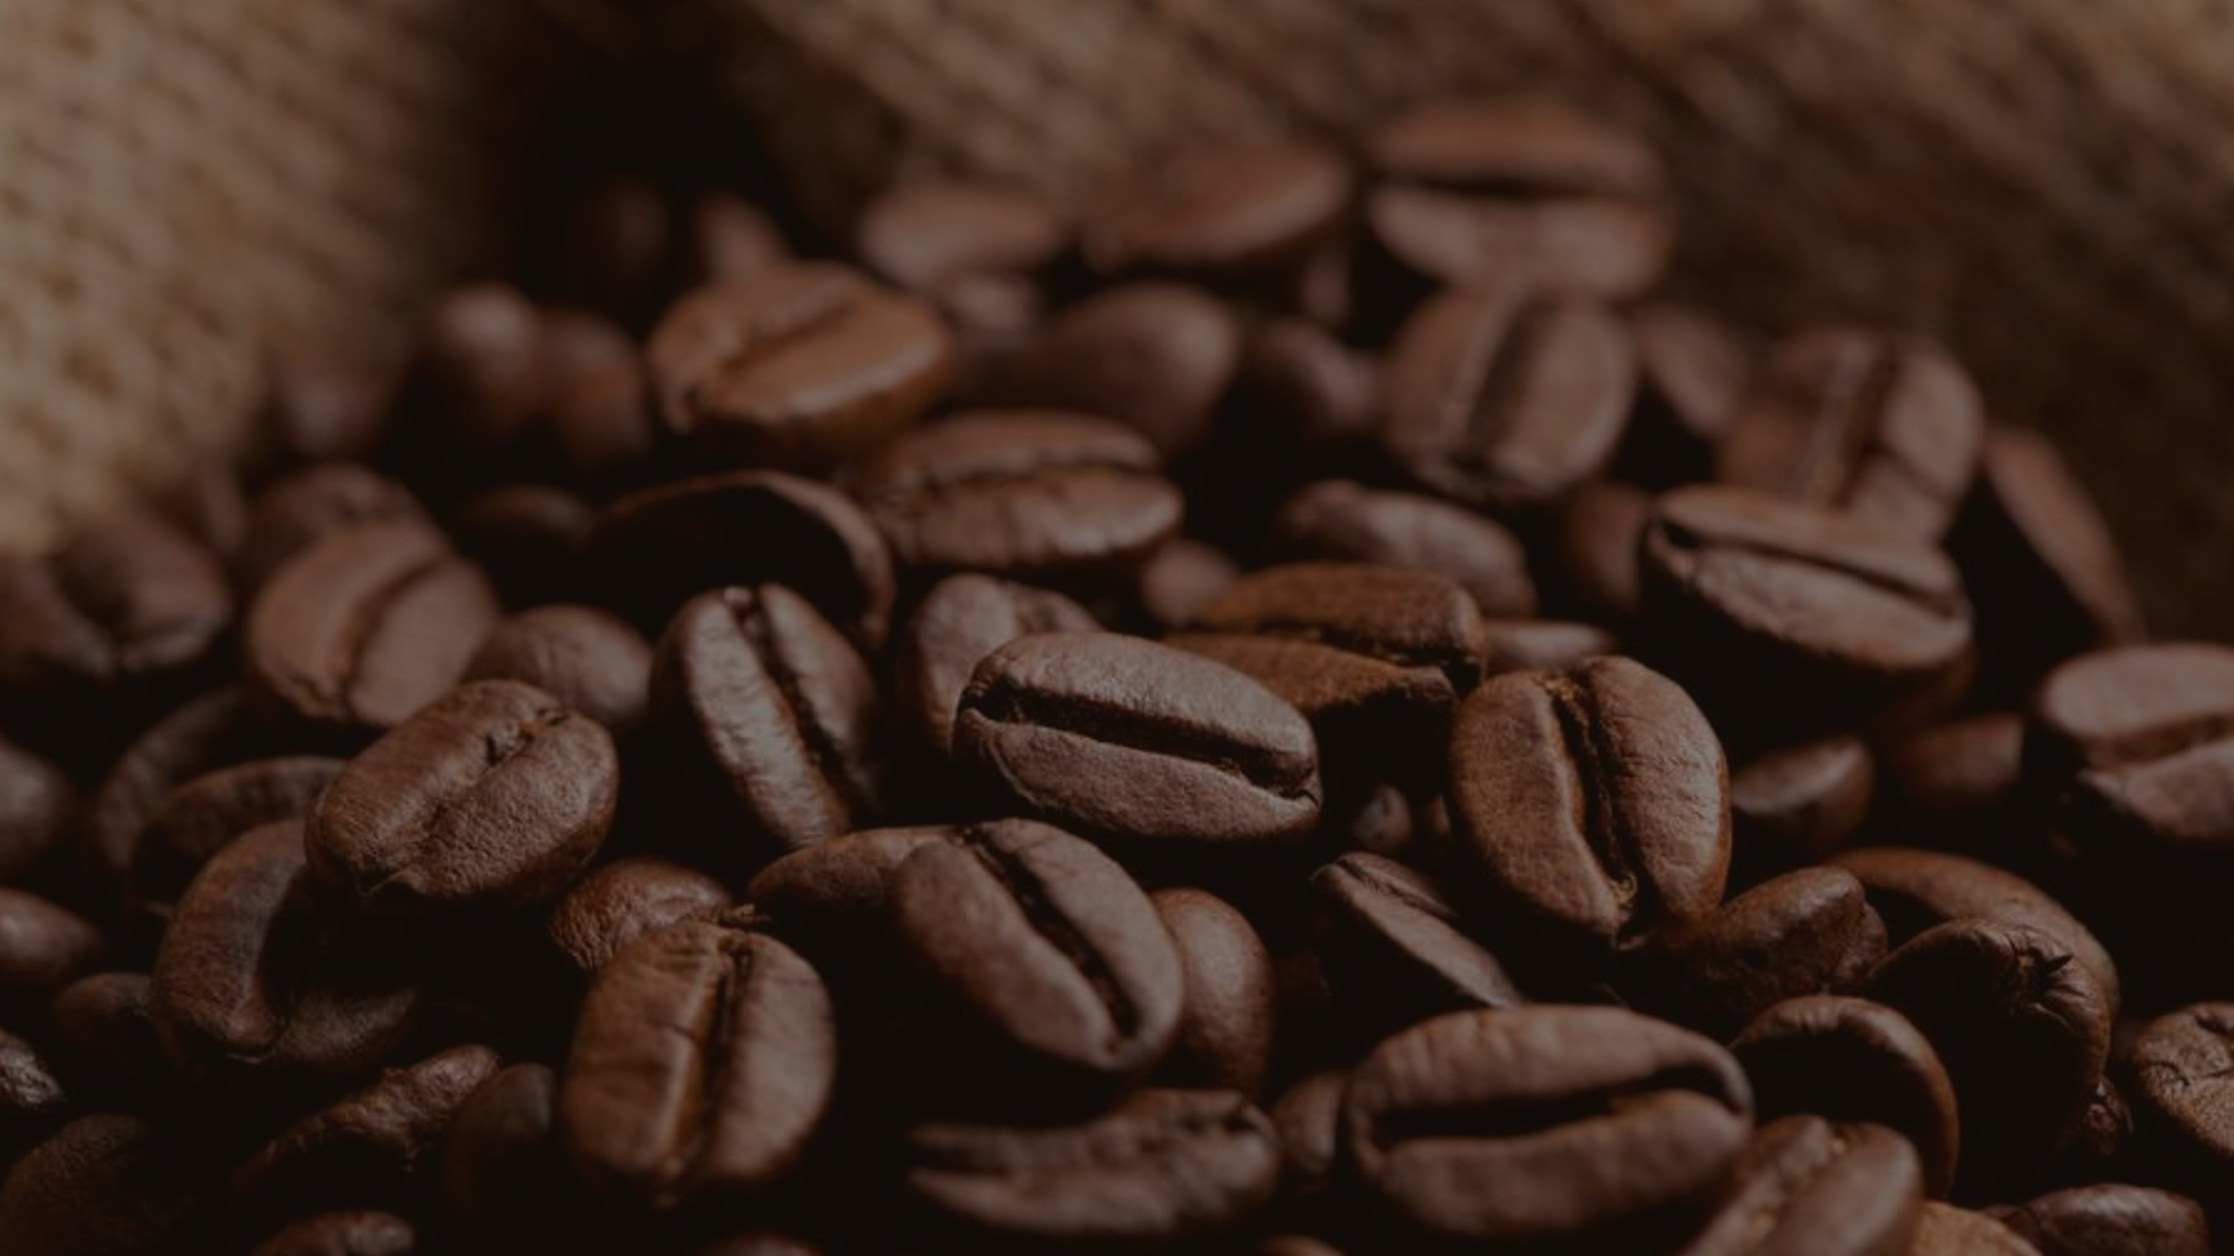

Thank you
Presented by :
AKASHDEEP DAM (UNID : UMIP20537)
akashdeepdam@gmail.com

